Slide 1
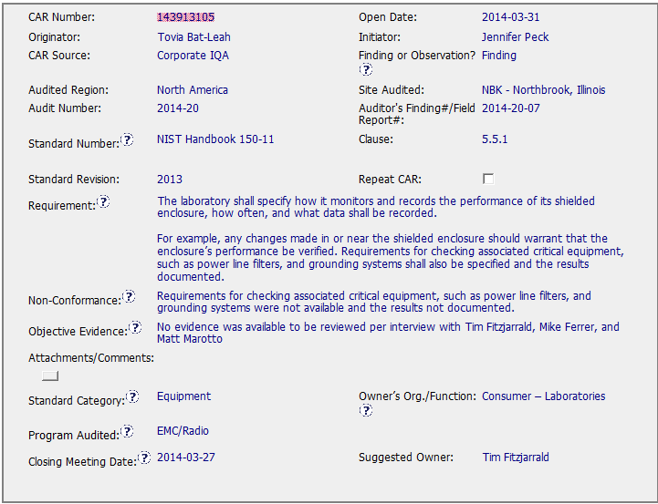
CAR 143913105 - Origination
The Requirement, NC, and OE are clear and concise.

Slide 2
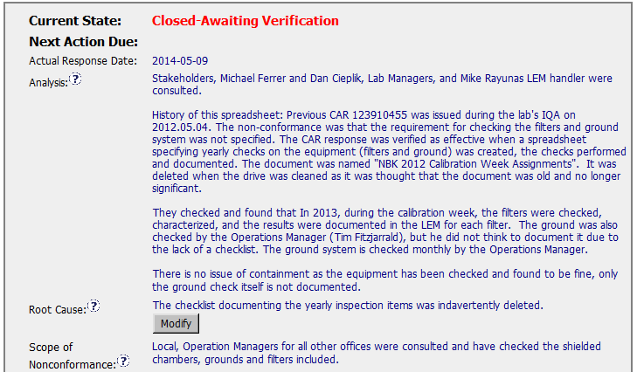
CAR 143913105
Stakeholders and History - Good.
The equipment check is not attached to this CAR to support the suggestion that containment is not required.
Attach results as evidence that the system is checked and acceptable!
It’s probably true, but not the greatest RC statement in the history of Root Cause Analysis.
Evidence of these checks?

Slide 3
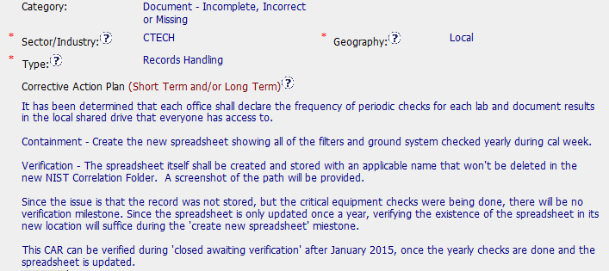
CAR 143913105
Accurate Selections
Evidence of this would be nice!
Explanation of why there is no verification milestone – good, and logical.
Since this spreadsheet is only used once a year this is a good explanation for how the CAR can be verified.
Corrective Action Plan Containment Identified and explained – Good
Verification Identified - Good
How/When Verification will take place – Good
Although all of the individual elements of the CAP are explained well – the overall CAP is somewhat confusing, i.e., the explanation of the verification and containment.

Slide 4
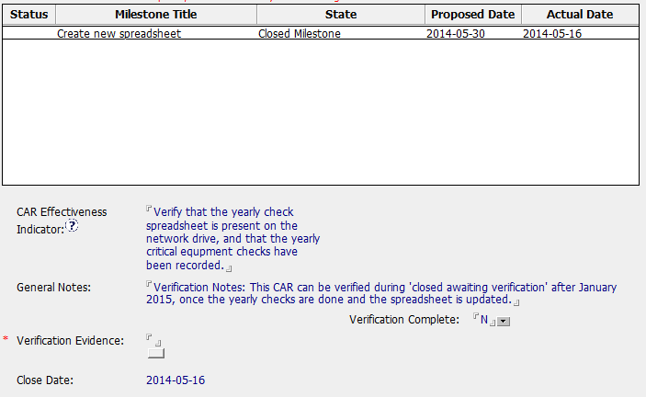
CAR 143913105
Containment should be part of the milestone name.
Example: Containment – Create New Spreadsheet
Milestone closed two weeks ahead of its due date – good!
Good explanation
Helpful, since the CAR Admin may not be the person who attempts to verify the CAR.

Slide 5
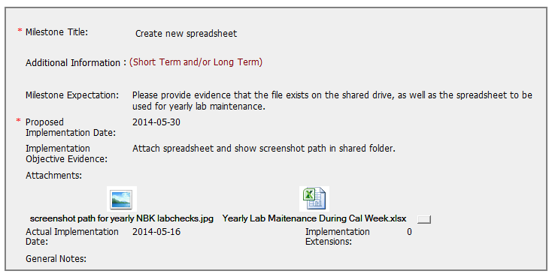
CAR 143913105
Simple, but clear expectation and the objective evidence.

Slide 6
CAR 143913105 Conclusion
CAR History – Very Clear
Comments by CAR Admin after Overdue notice and escalation notice
Response Disapproved note is very clear, with a clear expectation and explanation of what is ‘missing’ in order to approve the response/CAP.
Verification and Progress Check milestones shown as deleted in the CAR History just before the response was accepted. The updated CAP helps to explain this decision
Missing from Response/Analysis
Evidence of the checks to the shielded chambers, grounds, and filters.
(since I was the CAR Admin, I checked my email after reviewing the CAR, and found useful correspondence and a file attachment that would have been good evidence of the past checks which justify why there was no additional containment)
Other Items
Escalation path – good (No BU Presidents or names mentioned in FAQ #36)
CAR Assigned on 4/3 and closed on 5/16. Good!

Slide 7
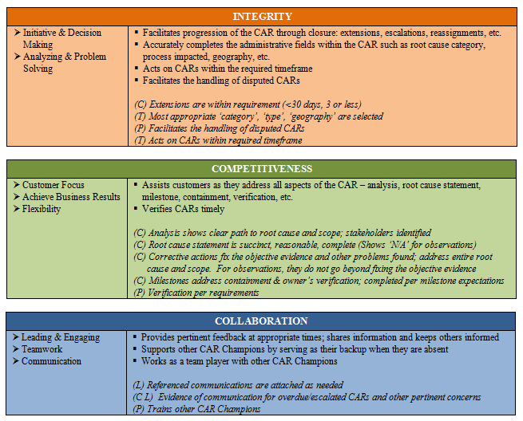
CAR 143913105 – Conclusion / CBS
Yes
N/A
Yes
N/A – Not Yet Verified (Timely, so far!)
Evidence of the checks that are indicated in the analysis are not attached to the CAR – this leaves a small gap in the overall CAP.
Yes
N/A

Slide 8
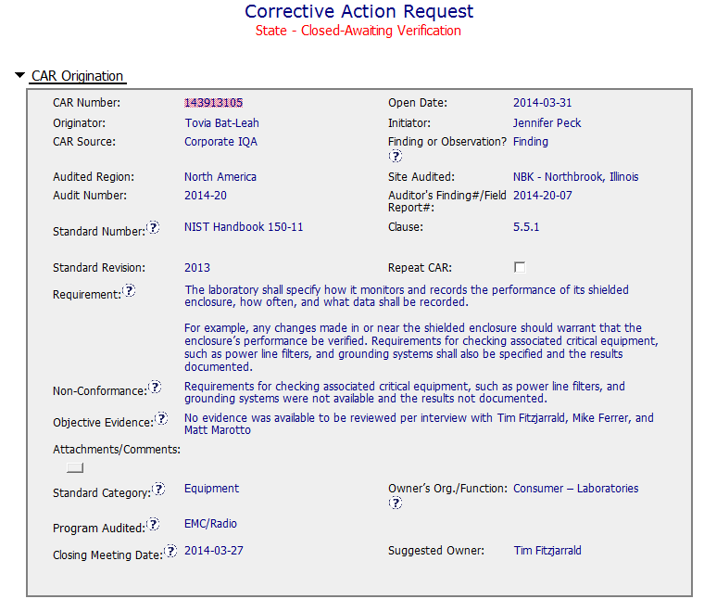
CAR 143913105 - Finding
No unique identifiers for equipment cited e.g.
- Equipment Id
Asset number etc.
Site has multiples chambers and filters
Team recognised this as a repeat CAR but not registered as such
Guidance not available

Slide 9
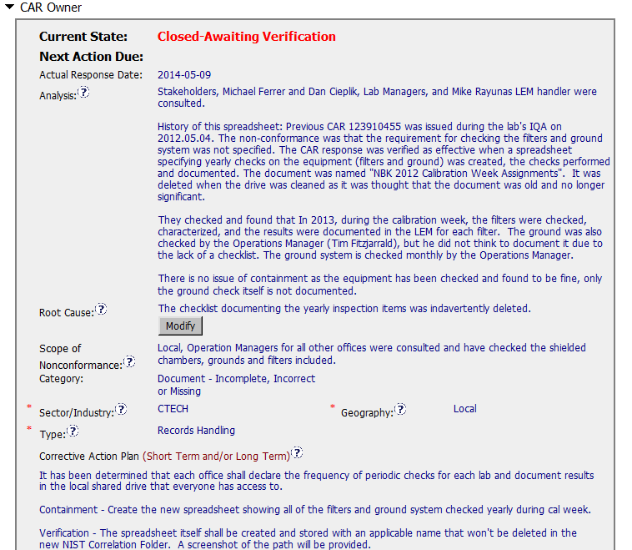
CAR 143913105 - Finding
Stakeholders identified but QM not involved
Limited evidence of structured analysis e.g. 5 Ys.
Scope – equipment and other offices impacted ?
Is trace back required ?
Root cause not deep enough e.g. ‘Ground’ check not documented.
Are requirements and responsibilities understood ?
Process issue ?

Slide 10
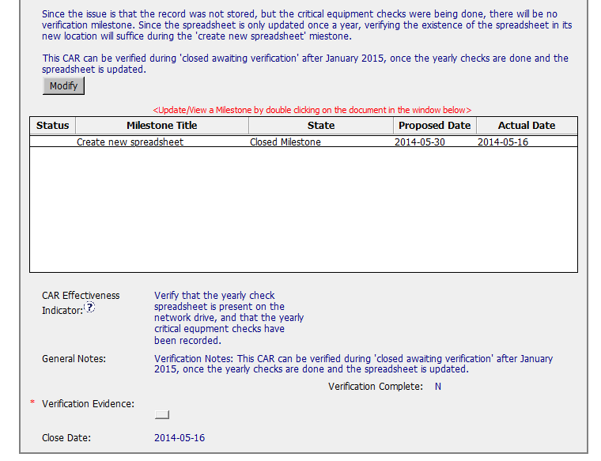
CAR 143913105 - Finding
Containment
Verification milestones ?
Requirements and responsibilities not addressed
Suggest this CAR is reviewed with the owner.

